Slide 1
COOPERATIVE LEARNING
A SUCCESSFUL TEACHING STRATEGY

Slide 2
WHAT IS IT!
A teaching strategy in which
SMALL TEAMS,
each with students of different levels of ABILITY,
use a variety of learning activities
to IMPROVE their UNDERSTANDING of a subject.
Each member of the team is responsible
not only for learning what is taught
but also for helping teammates LEARN,
thus creating an ATMOSPHERE of ACHIEVEMENT.

Slide 3

WHY USE IT?
Documented results include;
- Improved academic achievement,
- Improved behavior and attendance,
- Increased self-confidence & motivation,
- Increased liking of school & classmates.
IT IS ALSO EASY TO IMPLEMENT & UNEXPENSIVE!

Slide 4

REASONS FOR ITS IMPLEMENTATION
By implementing CL methods
1. One stimulates social skills such as:
- collaborating
- communicating
- taking responsibility
2. It is an effective way
of reaching cognitive goals.

Slide 5
LEARNING IN SCHOOLS IS AIMED AT:
The development of skills (motor skills, using instruments such as computers, reading, writing, communicating, collaborating,
reflecting etc.)
Acquiring information (factual knowledge, knowledge of procedures
and strategies, etc.)
The acquisition of understanding (we can speak of understanding when students are able to apply new knowledge to new situations and connect such knowledge to previously gained knowledge.
The development of attitudes ( we speak of attitudes when one’s view of an object or situation predisposes that student to act in a certain way, for instance leading him/her to take initiative and responsibility.

Slide 6
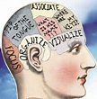

WHAT ACTIVITIES
CAN BRING ABOUT LEARNING
Remember: in giving activities to the students, they must always reach a certain goal.
Examples: Students learn a certain skill quicker if they are learned through doing, rather than through listening to a lecture or through reading.
Intellectual; skills such as cooperation, communication and learning are most effectively gained by doing.

Slide 7


LEARNING ACTIVITIES
THAT LEAD TO UNDERSTANDING
LISTENING READING
OBSERVING DISCUSSING
EXPERIMENTING (ALONE OR TOGETHER)
PREPARING AND EXECUTING
A PRESENTATION
INTERACTION FACILITATES LEARNING!

Slide 8
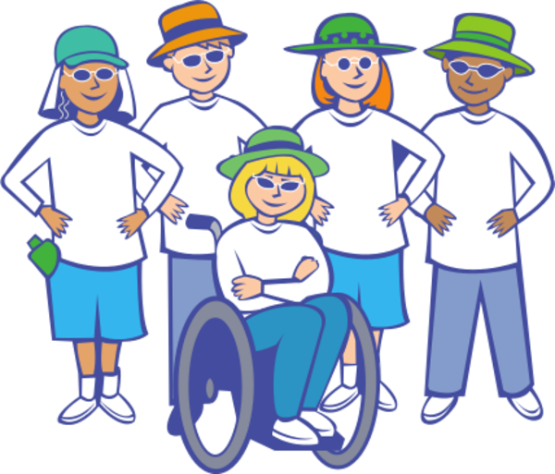

GROUP WORK
(8 in a group)
Think of an activity that involves
1. Observing
or
2 Preparing for a presentation
Specify grade level

Slide 9
CL’ S IMPORTANT ASPECT
GROUP WORK CANNOT BE CONSIDERED CL
UNLESS IT IS ORGANIZED
IN SUCH A WAY
THAT STUDENTS PARTICIPATE
IN THE INTERACTION

Slide 10

Participation in an interaction…
It is influenced by:
Organizational aspects
The content
The participants

Slide 11

ORGANIZATION
REFERS TO HOW THE GROUPS
ARE COMPOSED,
HOW THE CLASSROOM OR FURNITURE IS ARRANGED,
AND HOW THE TASKS AND RESPONSIBILITIES ARE ASSIGNED.

Slide 12
content
REFERS TO THE SUBJECT MATTER
(SHOULD BE EXPERIENCED AS INTERESTING AND USEFUL) AND THE ASSIGNMENTS (OPEN-ENDED QUESTIONS, ASSIGNMENTS THAT REQUIRE COLLABORATION).
THEY NEED TO BE RICH:
THEY NEED TO STIMULATE
THE CHILD’S LEARNING CAPACITIES

Slide 13
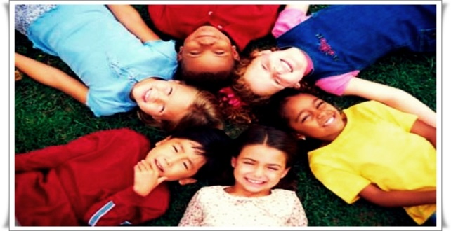
FORM INTERDEPENDENT TEAMS
In CL students are grouped into TEAMS composed of diverse students who care about helping one another learn – and about the success of the team itself.
ALL MEMBERS MUST KNOW THEY CAN DEPEND
ON ONE ANOTHER FOR HELP.
Teams work together daily for 6 -8 weeks, after that period,
Teachers assign new teams.
Team members move their desks together, choose the name of the team. At the beginning of the team’s work, members engage in group bonding activity, like creating a motto or coat of arms
to express their team personally.

Slide 14
SET GOALS
Students will do a lot more if they SHARE
a TEAM GOAL!
A team goal is
a TARGET, PRODUCT, or INDICATOR that shows a team has done a good job
of getting every member
to perform at his/her personal best.

Slide 15


ENSURE INDIVIDUAL ACCOUNTABILITY
IA means that to reach the team goal
all team members must master
the targeted content or skills.
Team success should depend on the hard work – and therefore the learning – of all members.

Slide 16
HOW CAN TEACHERS
ENSURE IA?
Make sure the TEAM GOAL REQUIRES the
LEARNING & PARTICIPATION of all team members.
For example, if the team goal is to score an average of 80 percent or better on a quiz, all students need to do well.
NEVER CHOOSE AN OUTCOME
ONE STUDENT CAN DO ALONE.
IT IS IMPORTANT THAT THE TEACHER
LETS THE WORK BE CHALLENGING
& DOESN’T STEP IN TOO EARLY
TO DO THE WORK
fOR STUDENTS TO STRUGGLE.

Slide 17
WATCHING A TRANSFORMATION
I once observed a class of 9th graders who started the school year reading significantly below grade level. Their first - year teacher worked hard to provide a research – based CL model in which they would read a wide variety of complex texts, discuss them in teams, and prepare one another to participate in class discussions. However the students were not making the desired progress. As the teacher looked for what was missing, she noticed students were sloppy in their work and slow to complete tasks. Although they often talked to one another, they weren’t helping one another. The first change the educator made was holding each student individually accountable for the work. The second was providing and discussing with the class rubrics for high quality answers or comments in discussions. Students and teachers practiced scoring sample answers and exchange feedback. Then she made the task more interesting, challenging, personal, and relevant. Team members were to help one another.
Result: Discussions flourished. Well-structured CL and recognition of work that met the standards of the rubrics transformed the class from remedial to advance,

Slide 18
CL’S EFFECTIVENESS
ON A RANGE OF OUTCOMES
STUDENT ACHIEVEMENT: When two necessary key elements – group goals and accountability –are used together, the effects on achievement are consistently positive.
IMPROVED RELATIONS AMONG DIFFERENT ETHNIC GROUPS:
One of the earliest and strongest findings shows that
students who cooperate with each other like each other.
MAINSTREAMING STUDENTS WITH LEARNING DISABIILITIES:
Significant improvement in relationships occur between these
students and other children in their class when these learning
strategies are used.

Slide 19
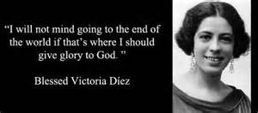
BLESSED VICTORIA DIEZ
Martyr, Public School Teacher, Member – Teresian Association
AN EXEMPLAR IN COOPERATIVE LEARNING

Slide 20
ACCORDING TO HER COLLEAGUES,
FRIENDS, SUPERIORS
“All the teachers in the town, both female and male agreed that Victoria’s was a model school. She herself knew her pupils one by one and was aware of their contexts. She lived up to her responsibility as a teacher like no one else. She was a teacher both inside and outside the school. She was a teacher to old and young alike.
Everybody knew, and it was gospel truth that Victoria is always moved by motives of humanity and not at all concerned with politics.
A colleague said, “As far as the school was concerned she gave her best. Whether they belonged to the upper crust or to the lowest rung of the social ladder, every one loved her.

Slide 21
hornachuelos
Recognized her as a pioneer
of women’s education,
not only because of her teaching, but because of her attention
to the whole person,
for her holistic approach to education.

Slide 22
REFERENCES:
Guilles, R. (2014) Cooperative Learning Development. International Journal of Educational Psychology
Slavin, R.E. (1995) Cooperative Learning: Theory, research, and Practice (2nd edition). Boston, Allyn and Bacon
Slavin, R.E.(2013). Classroom Applications of Cooperative Learning. In S. Graham (Ed.). APA handbook of educational psychology, Washington, D.C. American Psychological Association.
Galino, Angeles, Ask Me A Price (Oct. 2006)

Slide 23



THANK YOU VERY MUCH!
DAGHANG SALAMAT!
MARAMING SALAMAT!
May God bless you all!

